Slide 1
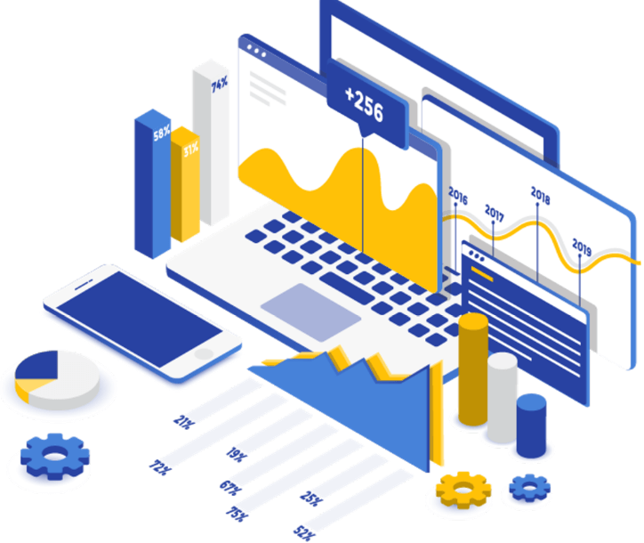






Technology Trends Analysis
Zachary Barnhart
12-22-2023

Slide 2



OUTLINE
Executive Summary
Introduction
Methodology
Results
Visualization – Charts
Dashboard
Discussion
Findings & Implications
Conclusion
Appendix

Slide 3

EXECUTIVE SUMMARY
Current Technology Usage Trends
Databases
Languages
Platforms
Future Technology Trends
Databases
Languages
Platforms
Demographic Survey
Gender and Country differentials

Slide 4

INTRODUCTION
About:
Analyzing the trends in software development
Purpose:
Identify skill requirements for future trends
Which programming languages are currently in demand?
Which database skills are currently in demand?
What are popular IDEs

Slide 5

METHODOLOGY
Data Collection Sources (Sources)
Stack Overflow Developer 2019 Survey
GitHub Job postings
Programming Languages Annual Salary
Data Wrangling
Data Exploration
Data Cleaning
Data Visualization
Python matplotlib
IBM Cognos

Slide 6
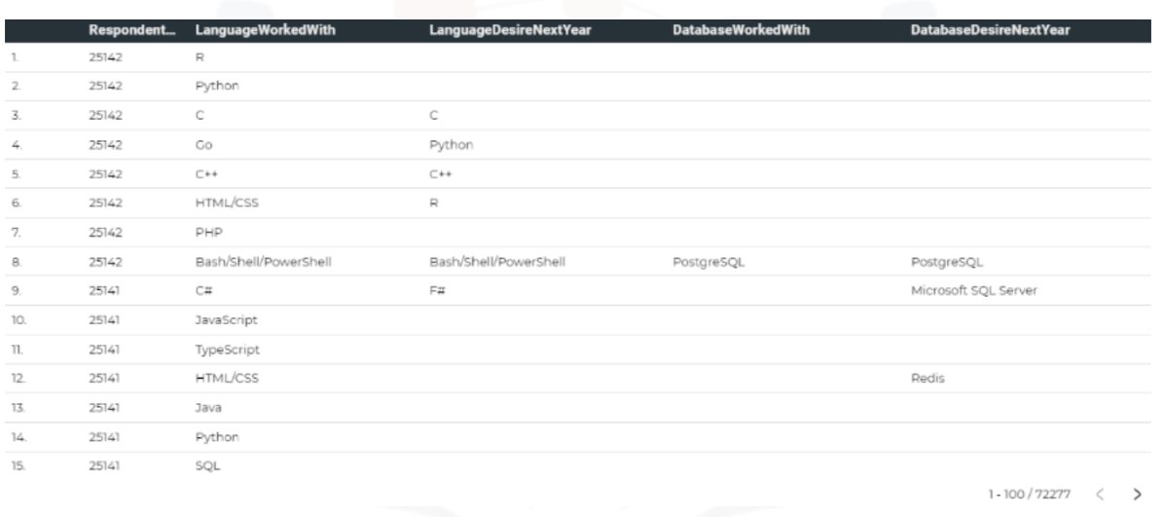
RESULTS

Slide 7
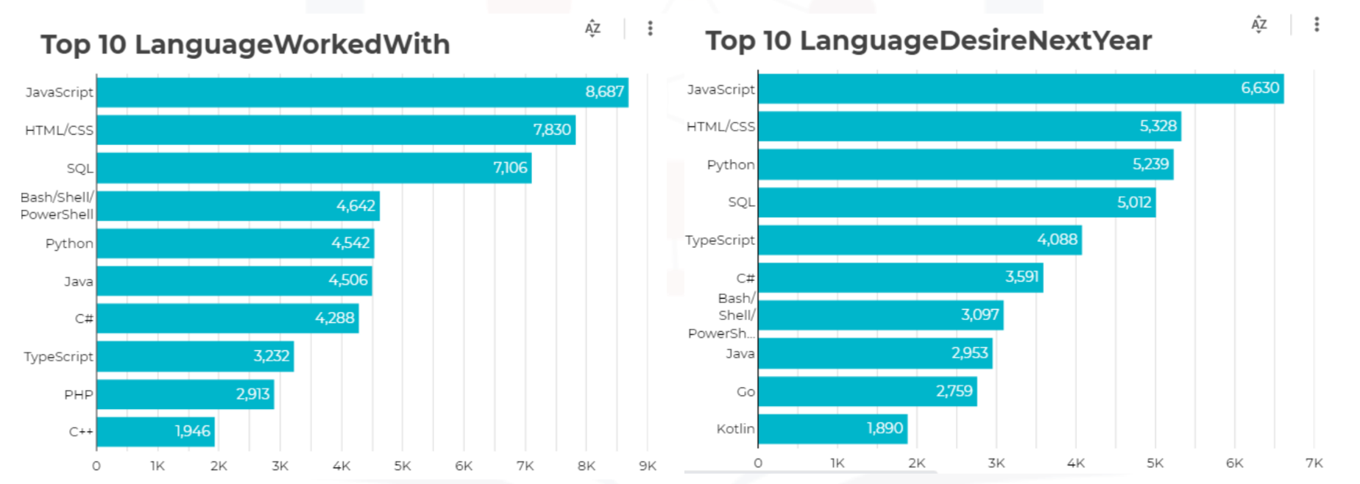
PROGRAMMING LANGUAGE TRENDS
Current Year
Next Year
<Bar chart of top 10 programming languages for the current year goes here.>
< Bar chart of top 10 programming languages for the next year goes here.>

Slide 8
PROGRAMMING LANGUAGE TRENDS - FINDINGS & IMPLICATIONS
Findings
JavaScript, HTML/CSS, SQL are most popular
Python and Typescript are projected to be more significant in the future
PowerShell will be less significant/popular in the future
Implications
Big Data technology still has a high demand for SQL
Web Development is in high demand
In regards to AI, ML is on the rise, Python is still a necessity and is in high demand

Slide 9
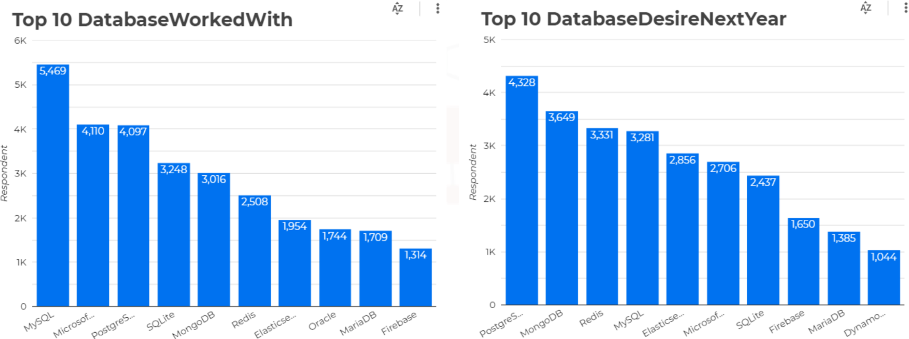
DATABASE TRENDS
Current Year
Next Year
< Bar chart of top 10 databases for the current year goes here >
< Bar chart of top 10 databases for the next year goes here.>

Slide 10
DATABASE TRENDS - FINDINGS & IMPLICATIONS
Findings
MySQL is in highest demand
Redis and MongoDB are gaining popularity
Elasticsearch is projected to have the highest increase in demand
Implications
Non-SQL databases will make a bigger impact on storing non-relational data
Open source databases are still preferable
Redis supports abstract data types

Slide 11

DASHBOARD
https://dataplatform.cloud.ibm.com/dashboards/d3d90b5e-6e1f-49fe-8996-eee064fac601/view/7d64f42a259520e94aedcce407cc78017c65205ce7bbd50a87d17b490d322797a93c1190c8274c58da130c36f6ed1b0cca

Slide 12
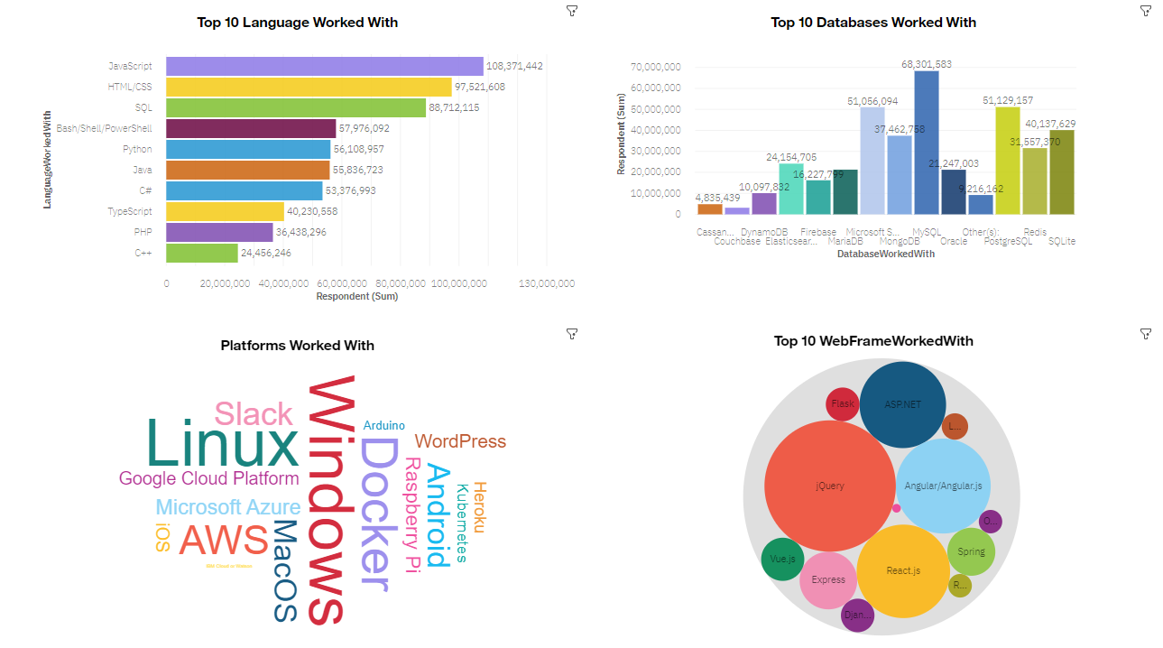
DASHBOARD TAB 1

Slide 13
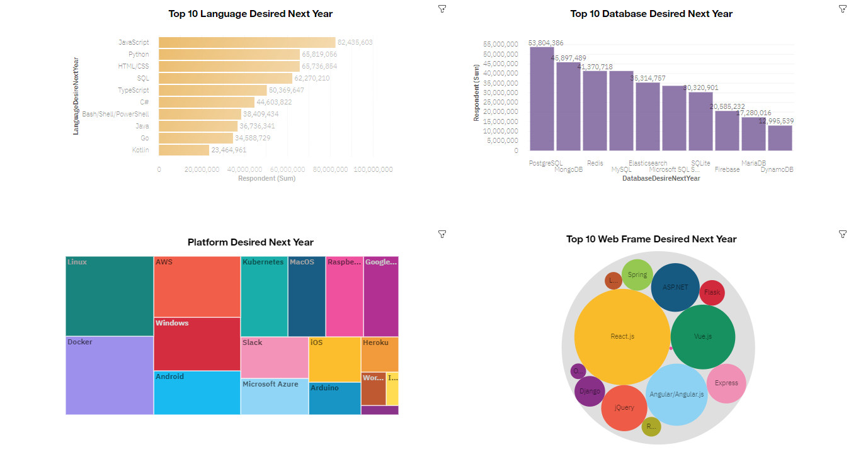
DASHBOARD TAB 2

Slide 14
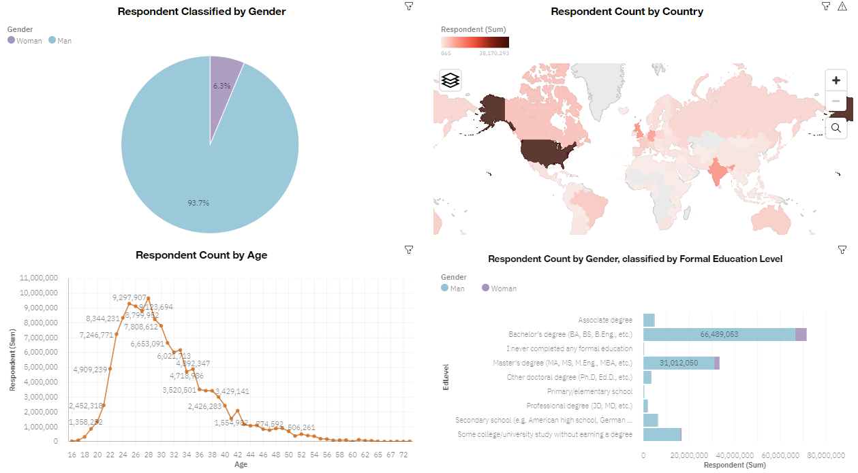
DASHBOARD TAB 3

Slide 15
DISCUSSION
Technology trends now and in the future
Training and in-field continuing education
Female representation in Technology fields
Bridge divide of technology gaps in developing countries
Address education and age discrimination in technology employment

Slide 16
OVERALL FINDINGS & IMPLICATIONS
Findings
Technology language and database demands change annually
High geographical concentration of Tech employees
Gender gap is evident
Platforms such as Docker and AWS are in increasing demand
Implications
Companies need to be agile and flexible with rapid and consistent changes
Technology could be more geographically diverse
A technology shift is foreseen to faster app development and cloud services

Slide 17

CONCLUSION
Technology trends now and in the next year can be used to predict what continuing education is needed and what needs to be learned to continue to advance successfully
Trends in popularity of different tools, languages, and platforms are evident
Gender inequality could be addressed, when different perspectives are desired
Technology job accessibility for developing countries needs to be increased

Slide 18
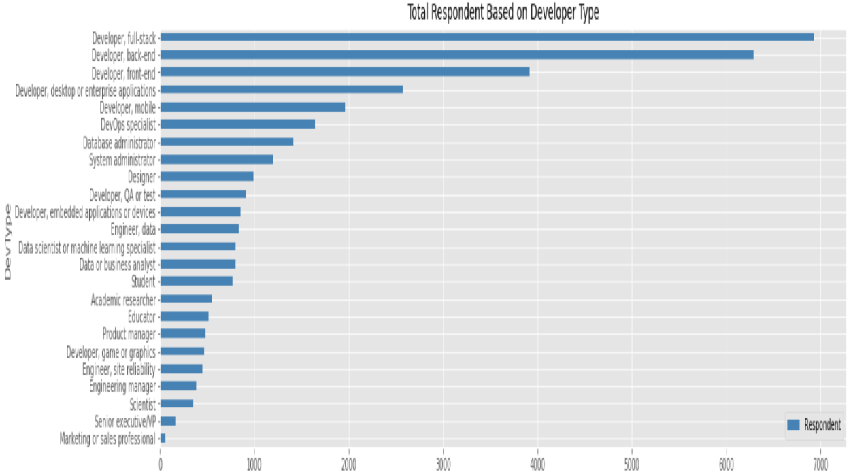
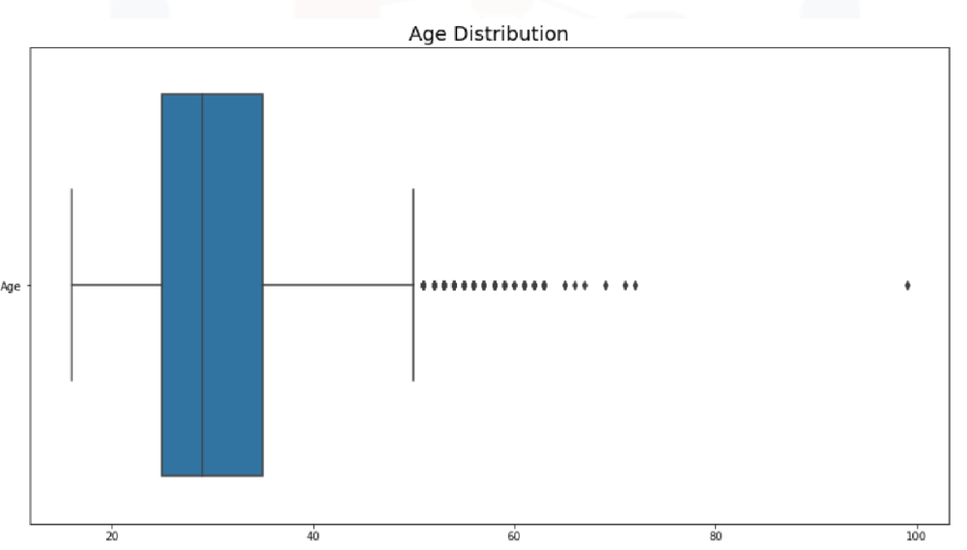
APPENDIX

Slide 19
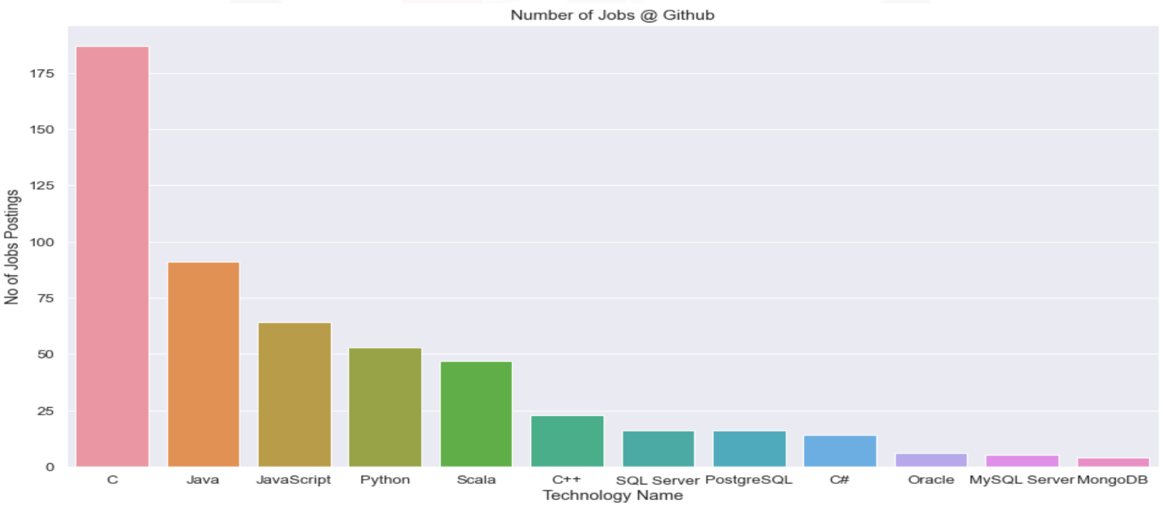
JOB POSTINGS

Slide 20
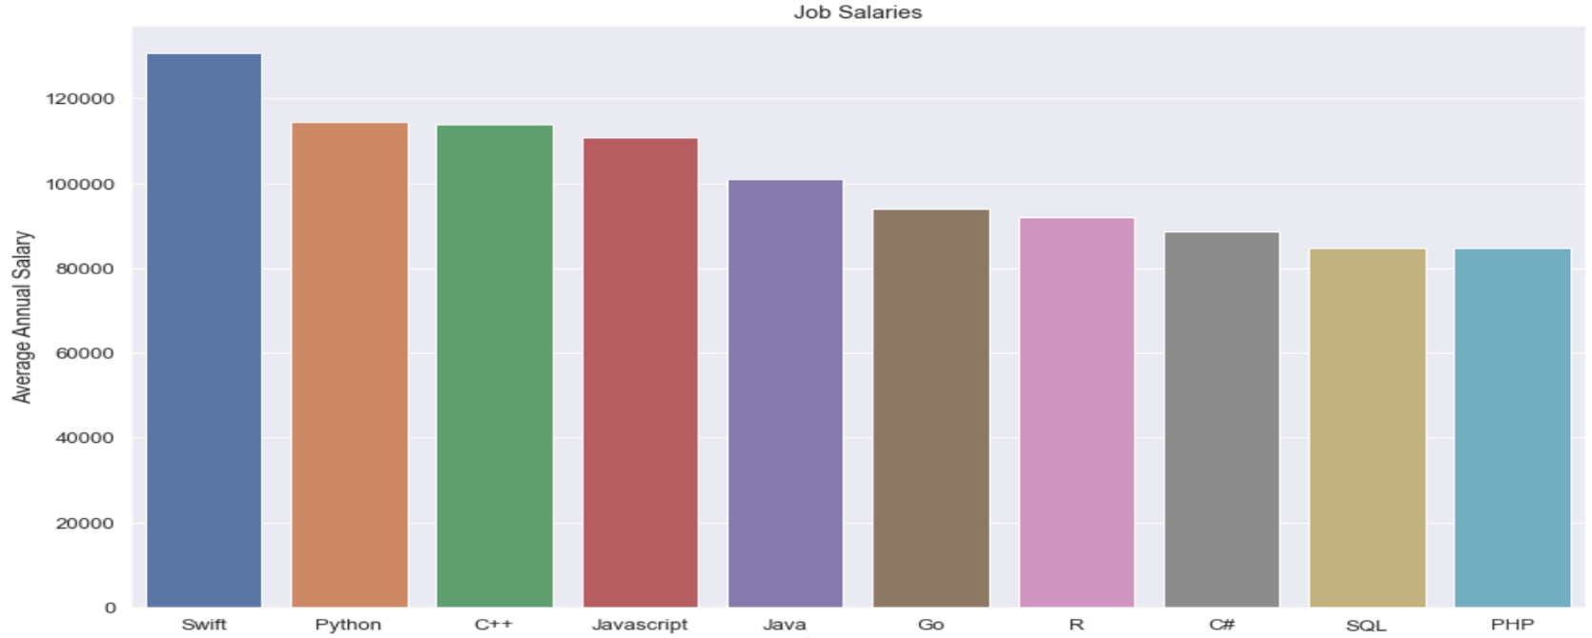
POPULAR LANGUAGES

